Slide 1
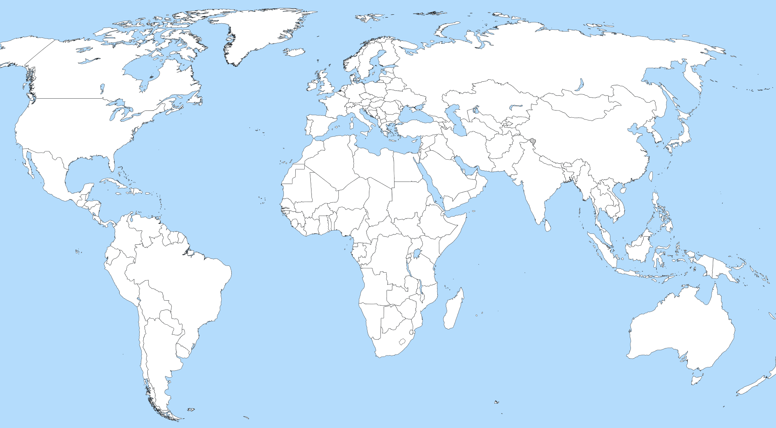
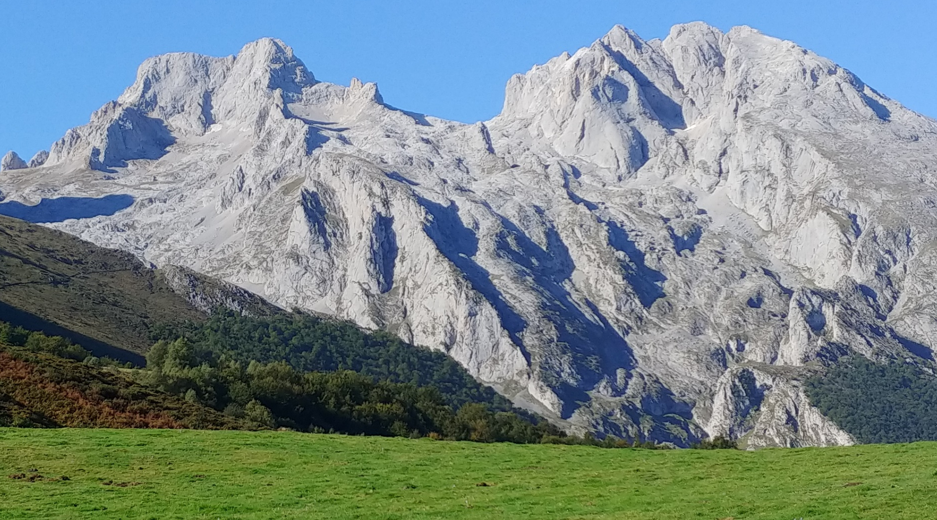
A) Latitudinal described pattern
C) Fatty acids biochemical properties
 | Unsaturated Fatty Acids (UFA) | Saturated Fatty Acids (SFA)
Production cost | Higher | Lower
Energy stored | Lower | Higher
Melting point | Lower | Higher
Oxidative damage | Higher | Lower
Particularities | Unpalatable Antifreezer
Stereochemistry
B) Altitudinal expected gradient
O
O
HO
HO
Oil content (%)
UFA/SFA ratio
"A large blank world map with oceans marked in blue mapamundi en blanco" by Jose carlos garcia lopez is licensed under CC BY-SA 3.0.

